Slide 1
Project 3: Pick Your Fighter
Sid Ali, Xiaoran Li, Sana Rogers, Meredith Johnson

Slide 2
Project Requirements
Analyze
Analyze and Visual an Issue: The likely winner in an MMA fight
Use
Use Machine Learning in technologies used: regression model
Scikit
Python Pandas
MongoDB
Matplotlin and PyPlot
HTML/CSS/Bootstrap
JavaScript D3.js
Demo
Demo of our work

Slide 3
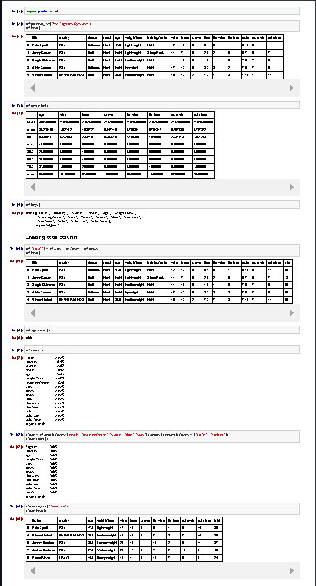
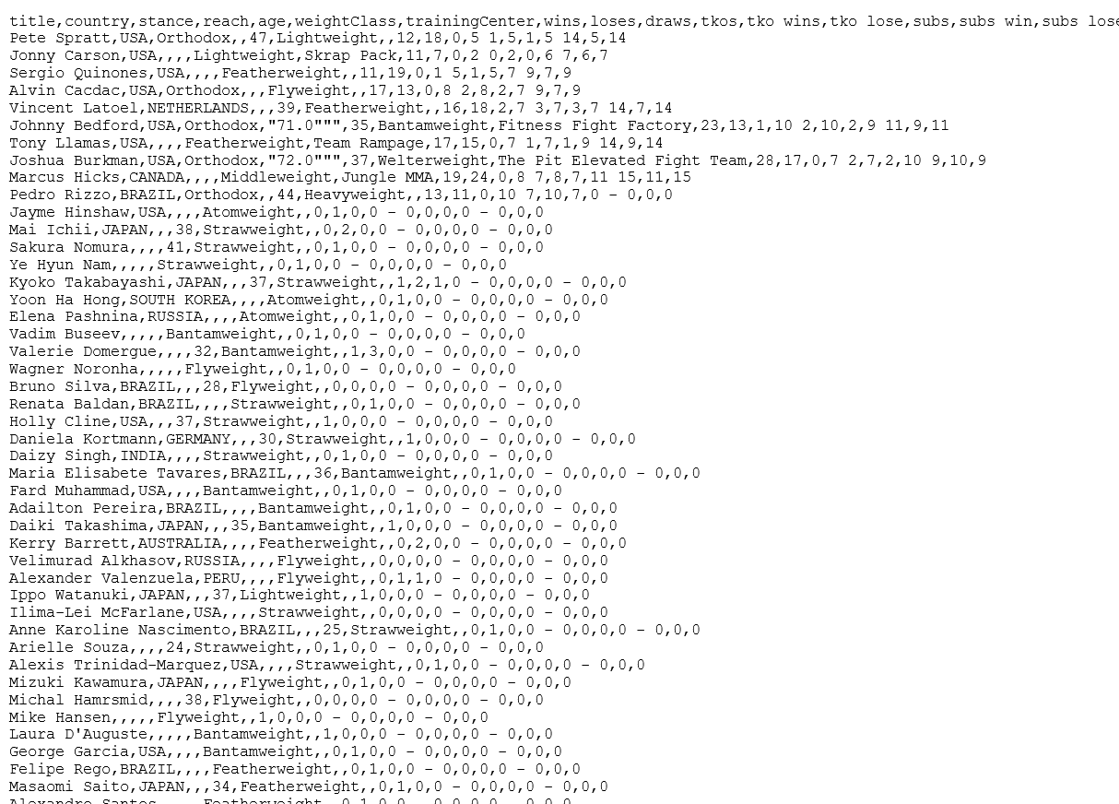
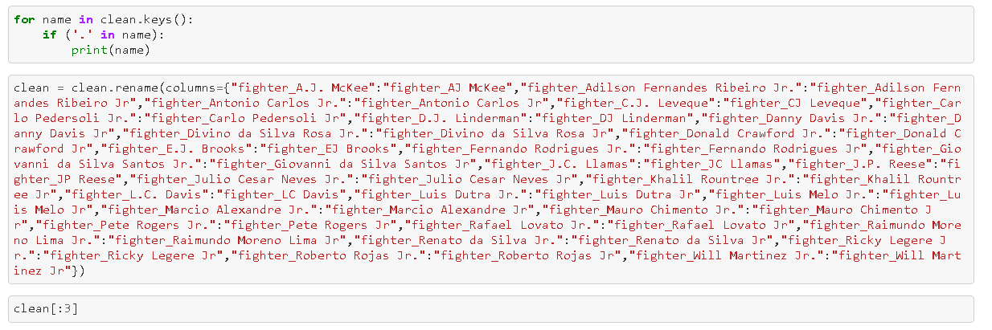
Step 1: Sourcing and Cleaning

Slide 4
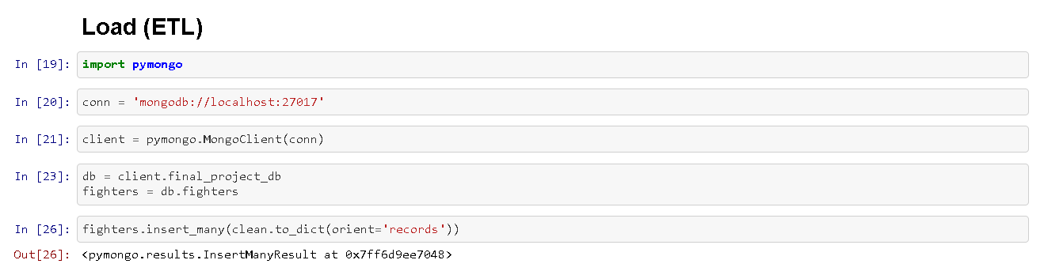
Step 2: ETL – assumed we’d use MongoDB

Slide 5
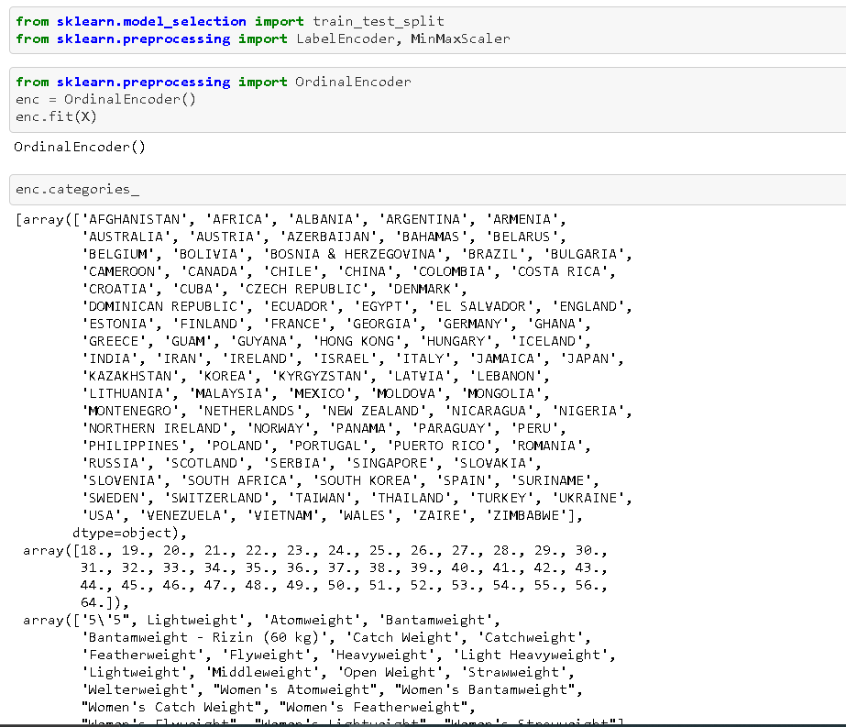
Step 3: Course Correction to use Scikit

Slide 6
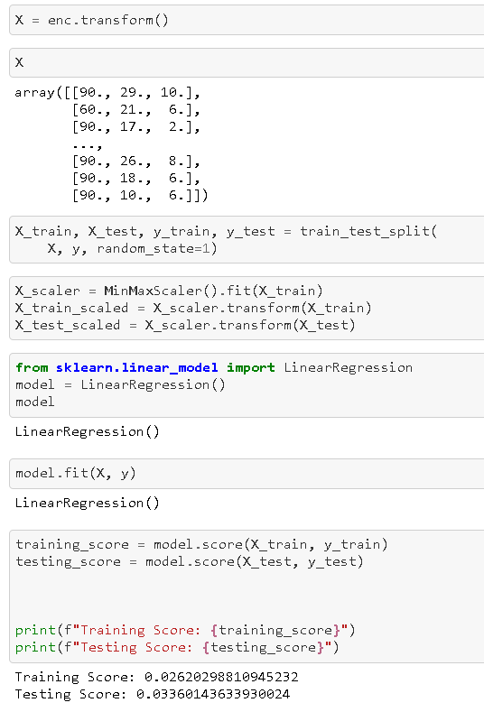
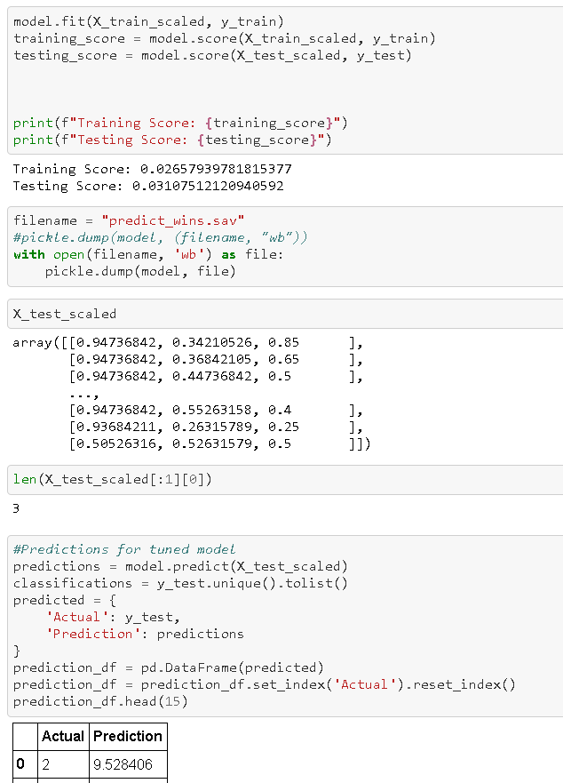
Step 4: Performed a Regression and Trained the Model

Slide 7
Built a website to visualize our model
Need pictures here

